Slide 1

Sentiment analysis
Using R programming
By Aishwarya and Priyanka

Slide 2
Steps
1
2
3
4
5
Get the Data
Import library
Read CSV file
R programming Code
Create a Barplot

Slide 3
How to Get data..
Steps
Add Google chrome extension – Amazon review export
Go to customer review page
Click on Start export review
it will export reviews in an excel sheet
Save the file as a CSV file
Clean the data

Slide 4
Code
#sentiment Analysis
library(syuzhet)
#read file
text_df1<-read.csv("Areview.csv",stringsAsFactors=FALSE)
# restored data in character format
review1<-as.character(text_df1$Content)
#obtain sentiment scores
get_nrc_sentiment('happy’)
get_nrc_sentiment('abuse')
#store this data set into new variable
s1<-get_nrc_sentiment(review1)
# combine text and sentiment columns
review_sentiment1<-cbind(text_df1$Content,s1)
#bar plot for sentiments
barplot(colSums(s1),col=rainbow(10),ylab='count',main='Amazon Feedback')

Slide 5
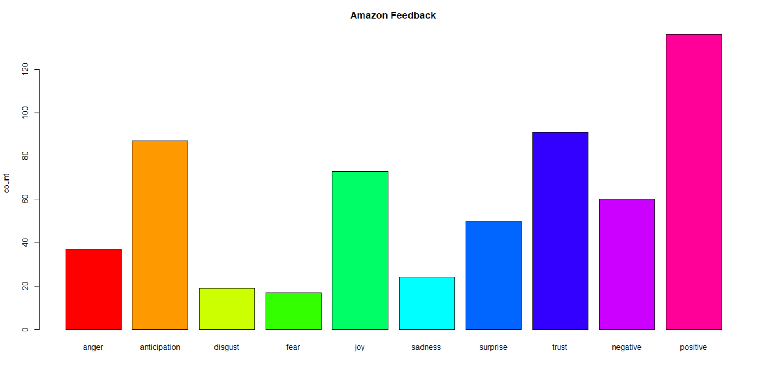

Slide 6
Summary
We have created a barplot for sentiment analysis using R Studio.

Slide 7
Thank you
YouTube link : https://youtu.be/nFICJq74Uek

